Slide 1
PHYISCS 114 SYLLABUS
Physics 114 – Spring 2019
Prof. Martin Guthold
Office: Olin 302, Lab: Olin 202
Phones: 758-4977 (office); 608-7304 (cell); 923-9902 (home)
e-mail: gutholdm@wfu.edu
OFFICE HOURS
Mo, We, Fr, 1:00 pm – 2:00 pm, 302 Olin
Feel free to drop by or make appointments, and I’ll try to accommodate you.
Physics 114 is the second course in a two-semester sequence in calculus-based general Physics. It does require the use of calculus and vector calculations. Calculus (Math 111) and Physics 113 (Mechanics, oscillations, waves) are a pre-requisite.
SCHEDULE
Lectures are on: M, W, F, 9:00 am – 9:50 am; room Olin 101
Labs:
All students must also enroll in one laboratory session. Labs will begin the week of Jan. 28; room Olin 104.
Labs cannot be made up on other days.
Attendance in the labs is required.

Slide 2
TEXT AND MATERIALS
Required text book: Physics for Scientists and Engineers, 9th ed. by Serway & Jewett vol. 2
Required: Sign up for WebAssign (~ $100 (includes e-book), more details below).
WebAssign & e-book are best deal
Required: For the lab you must get the lab manual from the bookstore (~$15).
Required: i-clickers (bookstore (~$30, new; many used ones available) or REEF app on cell phone (~$15), can be used for other classes))
Optional: Student solution manual (can help with some homework problems).
EXAMS AND GRADING
There will be one, comprehensive, 3-hour final exam and two1-hour, evening midterm exams given at the dates listed below. Homework problems will be assigned for each chapter and they will be also be graded.
1. Exam 20 %
2. Exam 20 %
Final Exam 30 %
Lab 15 %
Homework 10 %
i-clickers 5%
Participation can move borderline grades.
Exams:
Exam 1: Friday, Feb. 15, 4:00 – 5:00 pm or 5:00 – 6:00 pm (Chapters 23-25)
Exam 2: Friday, March 29, 4:00 – 5:00 pm or 5:00 – 6:00 pm (Chapters 26-29)
Final: Friday, May 10, 9:00 am – 12:00 pm (comprehensive, Chapters 23-29 & 35-38)

Slide 3
HOMEWORK AND PROBLEM SOLVING
Homework and problem solving is an important part of learning in a Physics course. Approximately 10-15 questions or problems per chapter will be assigned as homework. We will use WebAssign. Homework is usually due one or two lectures after it has been assigned. (Late HW – 10% reduction per day). Some homework problems may also re-appear on the exams and the final. You may collaborate on homework, but must submit your own work. Lots of help available (WebAssign, tutorials, instructor)
POSTINGS
Homework, practice exams, all lecture notes and all other material relating to the course will be posted on the web site for the class:
http://www.wfu.edu/~gutholdm/Physics114/phy114.html
To get ready for class: Print out lecture notes before class and bring to class. Go through notes, look at i-clicker questions, easy i-clicker may test reading at beginning of class).
WebAssign (http://www.webassign.net/) will be implemented for standard homework assignments. You have five attempts to get the answers.
Access codes to WebAssign (~$100, includes e-book) need to be purchased from the bookstore or WebAssign.
ATTENDANCE
It is expected that students attend all scheduled classes. Attendance at the two exams and the final is required. Absence on the exams will result in a zero grade unless an official excuse is presented. Excuses should be reported to me in advance.
i-clicker gives one point for attendance, one for each correct answer.

Slide 4
Lecture format:
Demos: Understand them &
and take notes.
(May pop up in exam)
Powerpoint presentations
Download from http://www.wfu.edu/~gutholdm/Physics114/phy114.html, print out (e.g. three slides on a page) and bring to lecture.
Lots of whiteboard work (bring note pad to each class; take notes!!)
i-clickers: Concept questions and quick quizzes with immediate feedback.

Slide 5




iclicker notes
Two options:
Purchase handheld i-clicker device; new (~$30) or used at bookstore.
Or: Download iclicker REEF app onto your phone as outlined on this webpage (need to open an account):
https://www1.iclicker.com/products/reef-polling/
Will get free demo trial for two weeks, then pay for subscription (6 months $14.99; or longer)
If you already have a REEF account, use it!
Add course: Institution: Wake Forest University; Our class is “Physics 114A (Guthold)” Spring 2019

Slide 6
Labs
- The labs take place in Olin 104
Lab manager:
  Eric Chapman (Olin 110), phone: 758-5532
Your lab teaching assistants (TAs):
Daraei, Ali (3)
Gao, Leda (1)
Need to buy lab manual
Labs start week of Jan. 28

Slide 7
PHY114 TUTOR SESSIONS
Sunday | Monday | Tuesday | Wednesday | Thursday | Friday | Saturday
Time and place to be announced
The tutor sessions in past semesters past were successful and received high marks from many students.
All students are encouraged to take advantage of this opportunity.
Some private tutors may also be available through the Physics office.

Slide 8
Pandemic Plan
In case of pandemic or major disaster striking the University (University closing, or instructor unavailable):
Tiered plan:
  Class might be covered by other instructor (if available).
  The lecture notes (ppt slides) will be distributed to you via the class web page, e-mail or regular mail.
  Short movies covering the major points may be posted on the class web page.
  You may be given a CD or DVD with all the lecture notes and exams to be taken.
  Exams will be taken on the dates indicated in the syllabus. Exams will be taken in a location to be announced or will be sent to you via web page, e-mail or regular mail.

Slide 9
Material covered in this class
(Chapters 23-29, 35-38, Physics for Scientists and Engineers, 9th ed. vol. 2)
Electricity and Magnetism
Electric Fields
Gauss’s Law
Electric Potential
  Exam 1 (Chapters 23 - 25)
Capacitance and Dielectrics
Current and Resistance
Direct-Current Circuits
Magnetic Fields
  Exam 2 (Chapters 26 - 29)
Light and Optics
Parts of chapter 34, Electromagnetic Waves
The Nature of Light, Ray Optics
Image Formation
Wave Optics
Diffraction Patterns and Polarization
Final exam (Chapters 23-29, 35-38)
(This material closely matches MCAT requirements)
(More Electricity and Magnetism)
Sources of Magnetic Field
Faraday’s Law
Inductance
Alternating-Current Circuits (tentative)
May cover some of this material
(Not needed for MCAT)
On average, we’ll spend about 3.5 lectures per chapter.

Slide 10
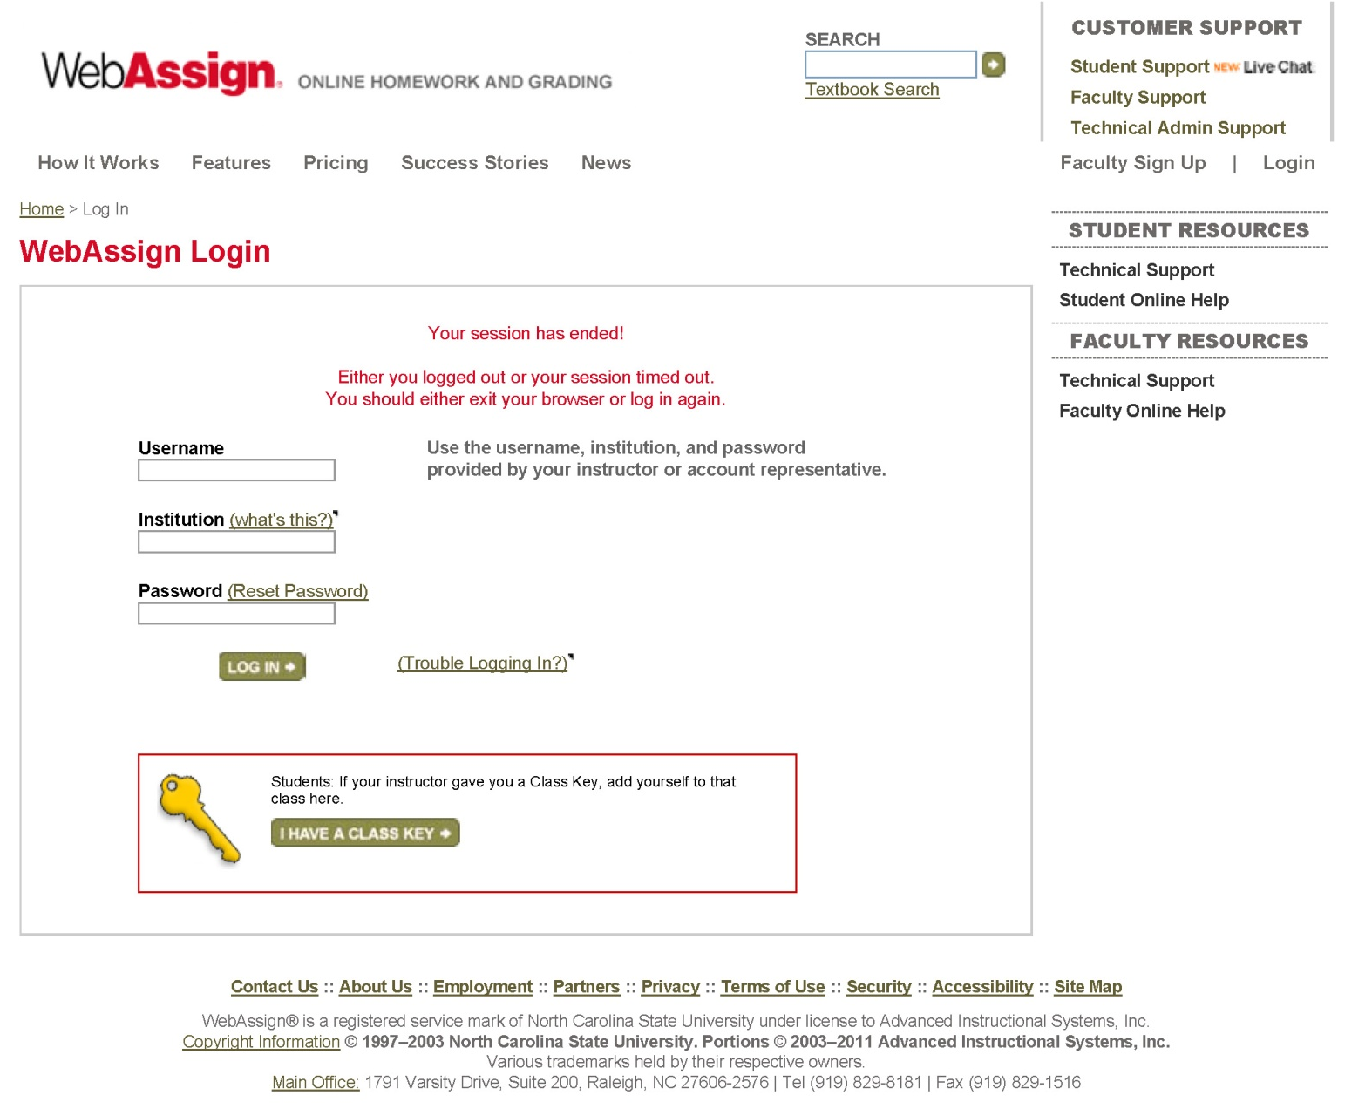
A few slides about WebAssign: https://www.webassign.net/login.html
Your e-mail address: e.g. gutholdm
wfu
W followed by WFU student ID, for example: W01030609 (or existing password)
Some students who already have accounts will be able to re-use them (but still need to pay for each class)

Slide 11
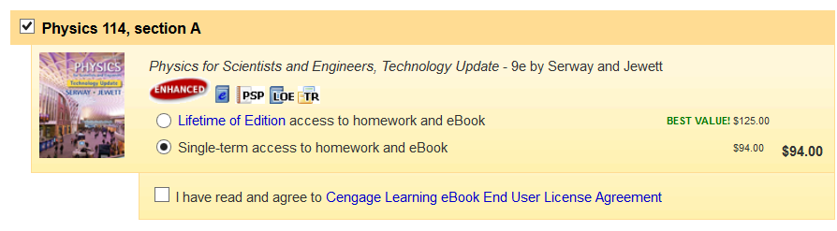
A few slides about WebAssign: What to purchase
Options:
Buy access code with hardcopy book.
Lifetime of Edition (LOE). Homework and eBook. You are allowed unlimited access to WebAssign courses that use this edition of the textbook. (~$125)
Single term access. Homework and eBook.
(~$100)
The e-book is basically just a nice electronic version of the book. You only need the hard copy textbook or the eBook (not both).

Slide 12
A few slides about WebAssign:
Notation, significant figures
Notation (use scientific notation):
2.32‧10⁻⁴ → 2.32e-4 (in WebAssign)
Need to use three significant figures (unless otherwise stated).

Slide 13
SI Units
Fundamental units
Time second s
Distance meter m
Mass kilogram kg
Temperature Kelvin K
Charge Coulomb C
Red boxes mean memorize this, not just here, but always!
Derived units
Force Newtons N kg ⋅m/s²
Energy Joule J N⋅m
Power Watt W J/s
Frequency Hertz Hz s⁻¹
Elec. Potential Volt V J/C
Capacitance Farad F C/V
Current Ampere A C/s
Resistance Ohm Ω V/A
Mag. Field Tesla T N⋅s/C/m
Magnetic Flux Weber Wb T⋅m²
Inductance Henry H V⋅s/A
Metric Prefixes
10⁹ G Giga-
10⁶ M Mega-
10³ k kilo-
1
10⁻³ m milli-
10⁻⁶ μ micro-
10⁻⁹ n nano-
10⁻¹² p pico-
10⁻¹⁵ f femto-

Slide 14

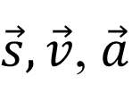
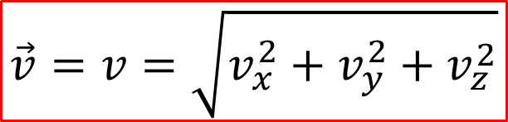
Vectors
A scalar is a quantity that has a magnitude, but no direction
  Mass, time, temperature, distance
  In a book, denoted by math italic font
A vector is a quantity that has both a magnitude and a direction
  Displacement, velocity, acceleration
  In books, usually denoted by bold face
  When written, usually draw an arrow over it
In three dimensions, any vector can be described
in terms of its components
  Denoted by a subscript x, y, z
The magnitude of a vector is how long it is
  Denoted by absolute value symbol, or
  same variable in math italic font
s, v, a
$\vec{s},\vec{v}$, $\vec{a}$
z
$\vec{v}=v_{x}, v_{y},v_{z}$
v_{x}
y
$$\vec{v}=v=\sqrt{v_{x}^{2}+v_{y}^{2}+v_{z}^{2}}$$
v_{z}
v_{y}
x

Slide 15
Finding Components of Vectors
If we have a vector in two dimensions, it is pretty easy to compute its components from its magnitude and direction
y
v
v_{y}
We can go the other way as well
v_{x}
x
Per definition, in 2D, θ is measured with respect to positive x-axis.
Magnitude in 3D:
Calculating the angles in three dimensions it is harder
  (Spherical coordinates; not in this class)

Slide 16
Unit Vectors
We can make a unit vector out of any vector
  Denoted by putting a hat over the vector
  It points in the same direction as the original vector
The unit vectors in the x-, y- and z-direction are very useful – they are given their own names
  i-hat, j-hat, and k-hat, respectively
  Often convenient to write arbitrary vector in terms of these
Adding and Subtracting Vectors
To graphically add two vectors, just connect them head to tail
To add them in components, just add
each component
Subtraction can be done the same way

Slide 17
Blackboard example
Vectors, vector addition, polar coordinates
A vector and a vector are given in
Cartesian coordinates.
Calculate the components of vector .
What is the magnitude of ?
Find the polar coordinates of .

Slide 18
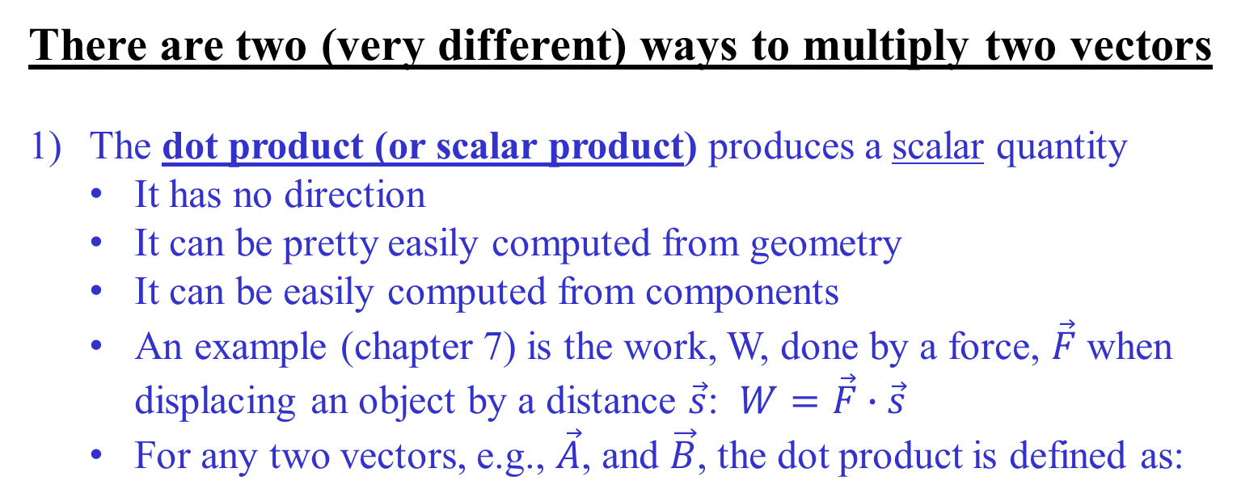
Multiplying Vectors
There are two (very different) ways to multiply two vectors
The dot product (or scalar product) produces a scalar quantity
  It has no direction
  It can be pretty easily computed from geometry
  It can be easily computed from components
  An example (chapter 7) is the work, W, done by a force, $\vec{F}$ when displacing an object by a distance $\vec{s}$: $W=\vec{F}∙\vec{s}$
  For any two vectors, e.g., $\vec{A}$, and $\vec{B}$, the dot product is defined as:
$$\vec{A}∙\vec{B}=\left|\vec{A}\right|∙\left|\vec{B}\right|∙cosθ=A_{x}B_{x}+A_{y}B_{y}+A_{z}B_{z}$$
θ is the angle between the vectors
Blackboard example: Dot product (and vector subtraction)
For $\vec{A}=3\hat{i}+3\hat{j}+5\hat{k}, \vec{B}=−2\hat{i}+2\hat{j}+7\hat{k}, and \vec{C}=3\hat{j}−3\hat{k}, find \vec{C}∙(\vec{A}−\vec{B})$

Slide 19
Multiplying Vectors
The cross product (or vector product) produces a vector quantity
(examples later)
  It is perpendicular to both vectors
  Requires the right-hand rule
  Its magnitude can be easily computed from geometry
  It is a bit of a pain to compute from components

Slide 20
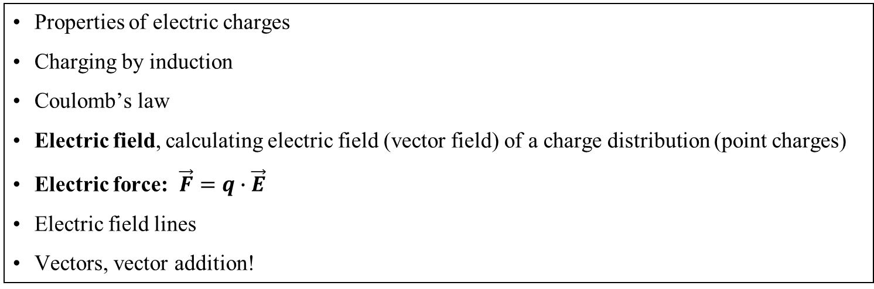
Chapter 23: Electric Fields
Reading assignment: Chapter 23, make sure to understand vectors
Homework Vectors, due Wednesday Jan. 23: Ch. 3: OQ1, 3, 11, 24, 29, 32, AE1, Ch. 7: 8, 9, 11
Homework 23.1, due Friday, Jan. 25: QQ1, QQ2, 1 (all homework is on WebAssign)
Homework 23.2, due Monday, Jan. 28: QQ3, 9, 12, 15, 17
Homework 23.3, due Wednesday, Jan. 30: QQ5, OQ7, 29, 31, 49, 53, 57, 72
Sign up (purchase access code) and check out WebAssign: http://www.webassign.net/
Purchase i-clicker, book, lab manual
Properties of electric charges
Charging by induction
Coulomb’s law
Electric field, calculating electric field (vector field) of a charge distribution (point charges)
Electric force: $\vec{F}=q∙\vec{E}$
Electric field lines
Vectors, vector addition!

Slide 21
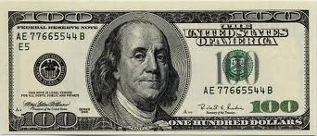
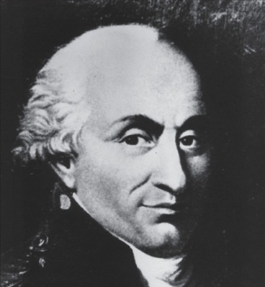
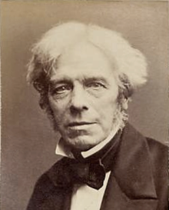
Chapter 23: Electric charge and electric field
Electrostatics: Interaction of charges which are not moving
Benjamin Franklin ( 1706-1790)
- Named positive and negative charges
Charles Coulomb (1736-1806)
- Forces between charges
Michael Faraday (1791-1867)
- Electric field

Slide 22
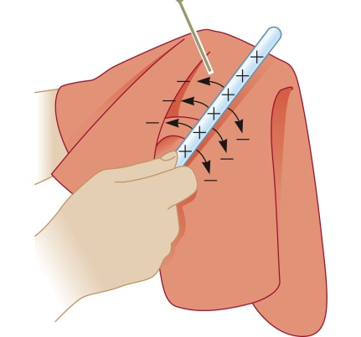
Franklin observed:
When rubbing objects together, charges can get transferred from one object to the other.
POSTIIVE CHARGE
Human Hands (usually too moist)
Rabbit Fur
Glass
Human Hair
Nylon
Wool
Fur
Lead
Silk
Aluminum
Paper
Cotton
Steel (neutral)
Wood
Amber
Rubber Balloon
Hard Rubber
Nickel, Copper
Brass, Silver
Gold, Platinum
Polyester
Styrene (Styrofoam)
Saran Wrap
Polyurethane
Polyethylene (like scotch tape)
Polypropylene
Vinyl (PVC)
Silicon
Teflon (very negative)
NEGATIVE CHARGE
Each transferred electron adds negative charge to the silk and an equal positive charge is left on the glass rod
Triboelectric sequence:
The items on top are less attractive to electrons and become positively charged, while the items on the bottom are more attractive to electrons and become negatively charged.
Thus, on contact between any two substances shown in the column, the one appearing above becomes positively charged, the one listed anywhere below it becomes negatively charged.

Slide 23
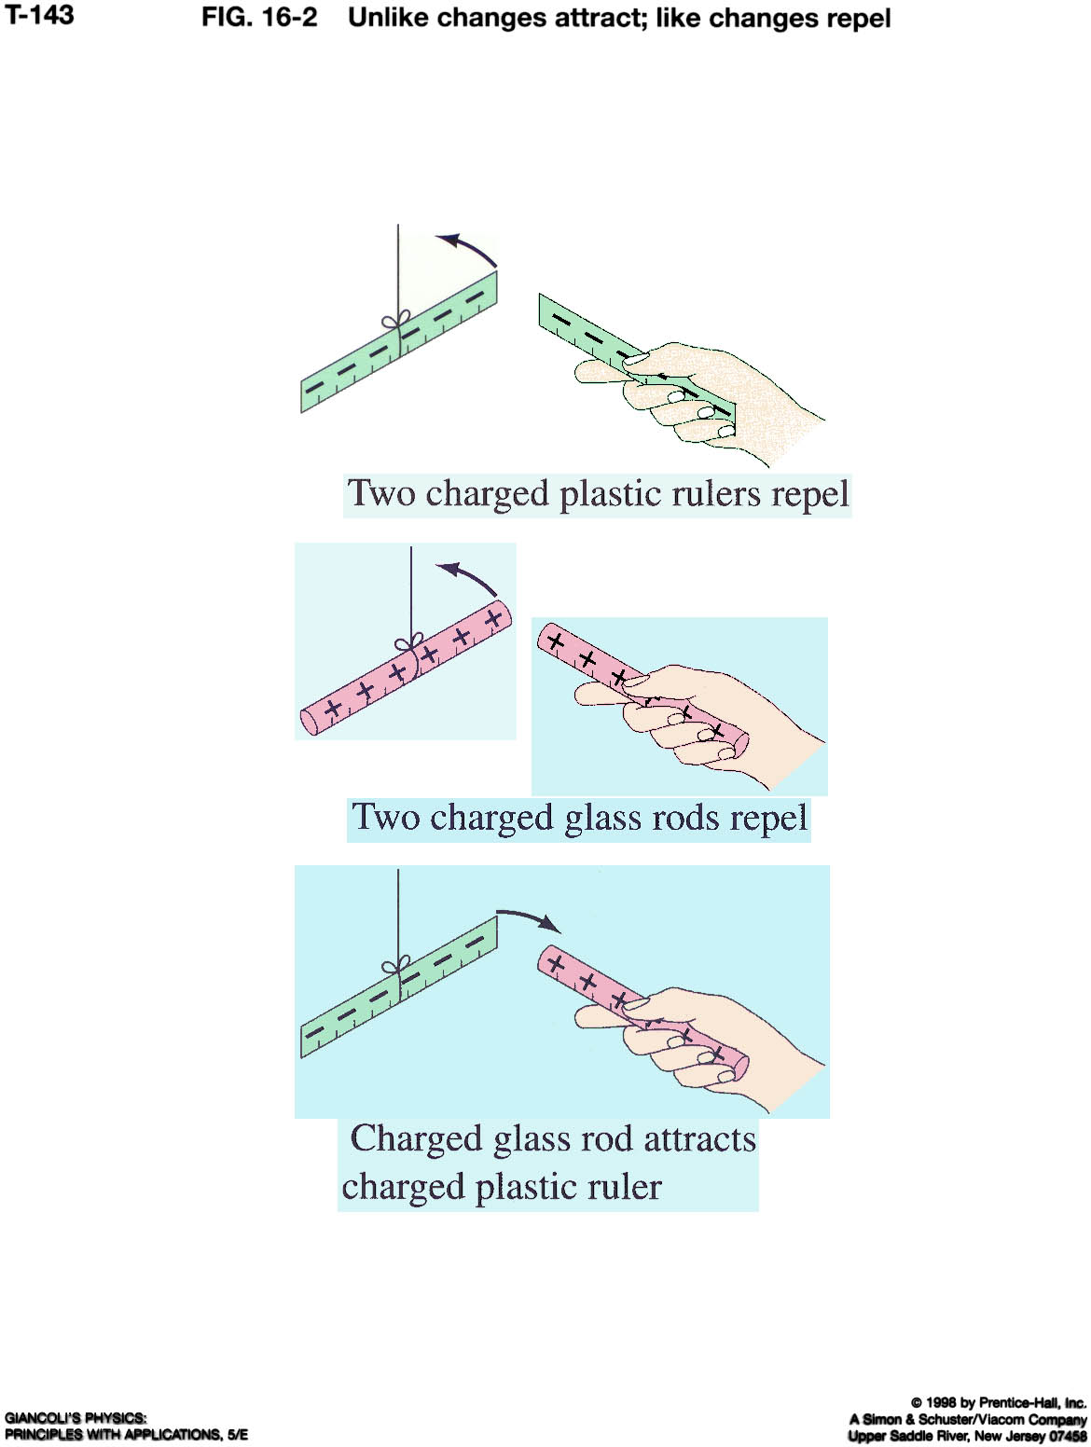
Properties of electric charges:
Two types: positive and negative (negative charge is carried by electrons and positive charge is carried by protons (see atom model in two slides))
Like charges repel
Opposite charges attract
Charge is conserved (net amount of electric charge produced in any process is zero)
Charge is quantized (charge is always an integer multiple of fundamental unit of charge, e = 1.6·10⁻¹⁹ C)
Unit of charge: 1 Coulomb (1C)
(= 6.25·10¹⁸ electrons)
From: Physics by Giancoli

Slide 24
i-clicker 23.1:
Three objects are brought close to each other, two at a time. It is found that object 1 and 2 repel each other and that object 2 and 3 repel each other. From this we can conclude that:
1 and 2 carry charges of opposite sign.
1 and 3 carry charges of opposite sign.
All three carry charges of the same sign.
One of the objects carries no charge.
We know the sign of all charges.
From: Physics by Giancoli

Slide 25
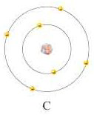
The nature of matter
Nucleus:
(consists of protons (positive) & neutrons (neutral)
Atoms (important facts):
Atomic radius: about 0.03 nm to 0.3 nm, depending on atom type (position of electrons is not well defined)
118 different types (elements), 109 are stable (table of elements)
Consist of a nucleus, orbited by electrons
Electrons are negatively charged
Nucleus consists of protons and neutrons
Protons are positively charged
Atomic number = number of protons
Number protons unequivocally determines element
(e.g. 6 protons = carbon)
Number or neutrons is about equal to number of protons, but it can vary for any given atom → different isotopes
Electrons
(negative)
e-
Matter:
Nuclei with positive charges
Surrounded by ‘sea’ of electrons. Some electrons may be tightly bound to an atom, others not.
-
-
-
-
-
-
-
+
+
+
+
+
+
-
-
-
-
-
-
-
+
+
+
+
+
+
-
-
-
-
-
-
-
C+
+
+
+
+
+
+
-
-
-
-
-
-
-
+
+
+
+
+
+
Ion:
Atom +/- Electron
-
-
-
-
-
-
-
+
+
+
+
+
+

Slide 26
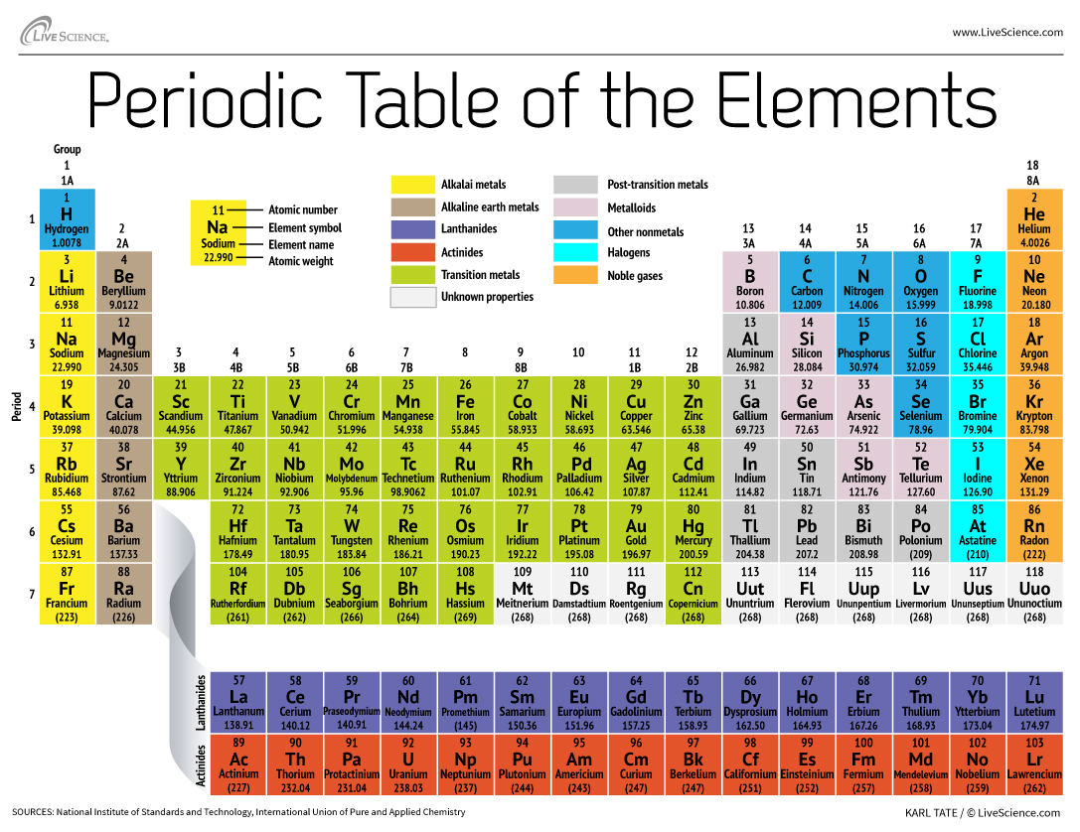

Slide 27
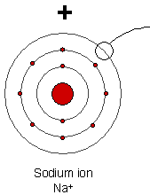
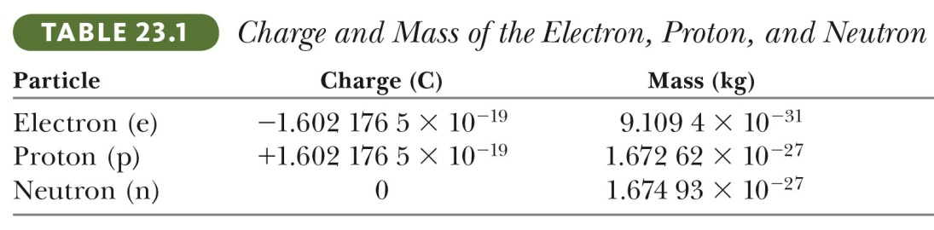
White board example 23.1.
What is the charge and (average) mass of a single Na⁺ ion?
(Hint: Na has atomic mass 22.99; thus, 1 mole ( 6.022·10²³ particles) of Na atoms have mass 22.99 g. The atomic mass unit (1/12th the mass of carbon atom) is 1.66·10⁻²⁷ kg.)
Image of sodium ion: http://faculty.clintoncc.suny.edu/faculty/michael.gregory/files/bio%20100/bio%20100%20lectures/chemistry/chemistr.htm

Slide 28
Insulators and conductors
Insulators: Materials in which the electrons are tightly bound to the nucleus and are not free to move through the material (glass, rubber, plastic, dry wood are good insulators)
Conductors: Materials through which the electrons are free to move (typically metals: silver, gold, copper, mercury)
Semiconductors: Materials with a few free electrons and the material is a poor conductor. At higher temperatures electrons break free and move through the material (silicon, germanium, carbon (graphite)). Can be doped (add other elements) to adjust conductivity.

Slide 29
Some ways to charge objects
By rubbing them together (triboelectric, tribo (greek) = to rub)
  Not well understood
By chemical reactions
  This is how batteries work
By moving conductors in a magnetic field
  Get to this later
By connecting them to conductors that have charge already
  That’s how outlets work
Charging by induction
  Bring a charge near an extended conductor
  Charges move in response
  Separate the conductors
  Remove the charge
–
+
–
+
+
–
–
+
–
+
+

Slide 30
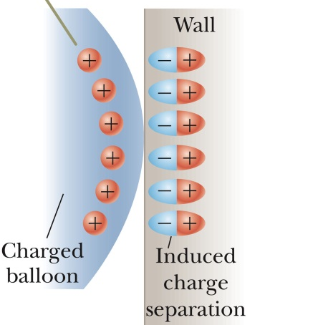
i-clicker 23.2:
Three objects are brought close to each other, two at a time. It is found that object 1 and 2 attract each other and that object 2 and 3 repel each other. From this we can necessarily conclude that:
1 and 3 carry charges of opposite sign.
1 and 3 carry charges of equal sign.
All three carry charges of the same sign.
One of the objects carries no charge.
We need to do more experiments to determine the sign of the charges.
Related: How do balloons stick to a wall?

Slide 31
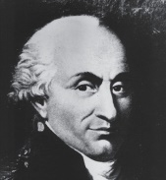
Coulomb’s Law
Like charges repel, and unlike charges attract
The force is proportional to the charges
It depends on distance
q₁
q₂
Notes
The r-hat just indicates the direction of the force, from 1 to 2
The Force as written is by 1 on 2
Sometimes this formula is written in terms of a
quantityε₀ called the permittivity of free space
Coulomb constant

Slide 32
i-clicker 23.3:
Object A has a charge of +2 μC and object B has a charge of +6 μC. Which statement is true about the electric force on the objects?
Electric force and gravitational force have same functional form. Unless we have big masses, the electric force is typically much larger than the gravitational force.

Slide 33
Whiteboard problem 23.2
Three point charges are located at the corners of an equilateral triangle as shown below. Calculate the net electric force on the 7.0 μC charge.
Use vector addition

Slide 34
Announcements:
Don’t need to turn in drawings, but know how to do them.
Deleted on problem (atoms, etc)

Slide 35
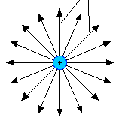
The electric field
(important – will come up many times this semester)
Many forces are ‘contact forces’, that require contact between objects (e.g. hammer and nail, friction between tires and road)
Gravitational and electrical force act over a distance (even through vacuum) → field forces
Faraday developed the idea of a field:
An electric field extends outward from every charge (source charge) and permeates all of space.
Definition: The electric field, , at any point in space is defined as the force, , exerted on a tiny positive test charge, +q₀ at that point, divided by the magnitude of the test charge.
Test charge q₀
Q
The electric field of a positive point charge Q

Slide 36
The electric field
is independent of the tiny test charge, q₀, and only depends on the source charge, Q, which produces the field.
points away from a positive charge and points toward a negative charge.
is a vector field, it has a direction in space everywhere.
Unit is N/C (Newton/Coulomb) (later: also Volt/meter)
Electric field of a point charge:
Test charge q₀
+Q
The electric field of a positive point charge Q

Slide 37
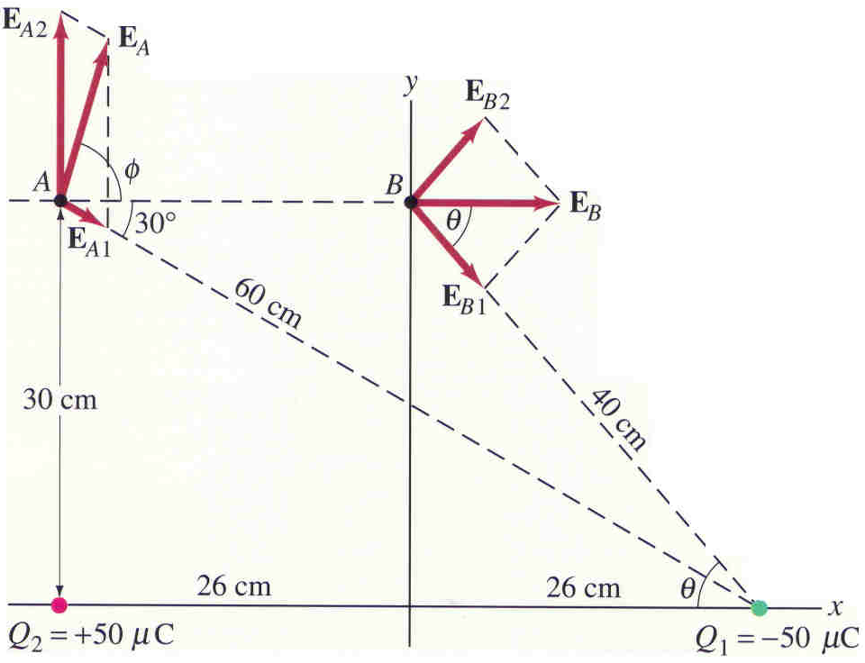
Electric Field from Discrete Distribution of Charges
The electric field at point P due to a group of source charges
can be written as the vector sum of all the individual fields:
White board example 23.3 (field of a dipole)
Calculate the total electric field at point A and at point B due to both charges, Q₁ and Q₂.
Use symmetry to save work, when possible.

Slide 38
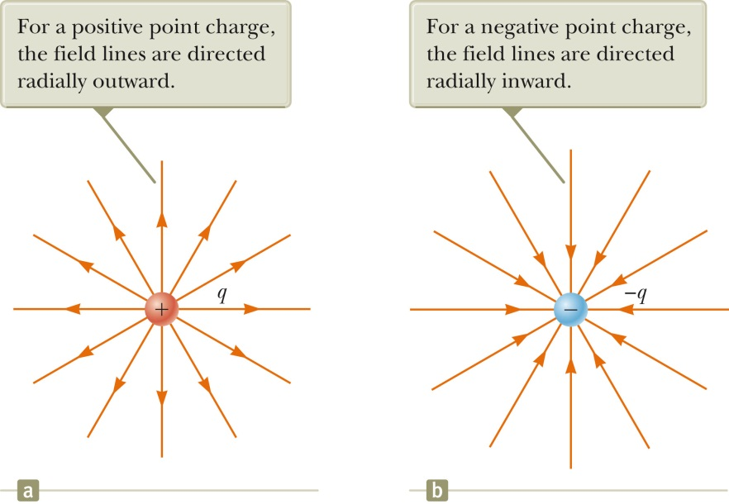
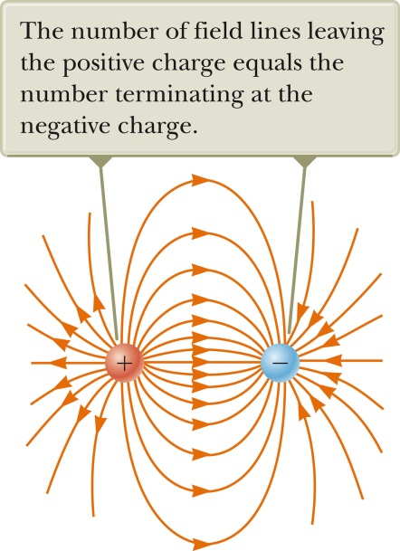
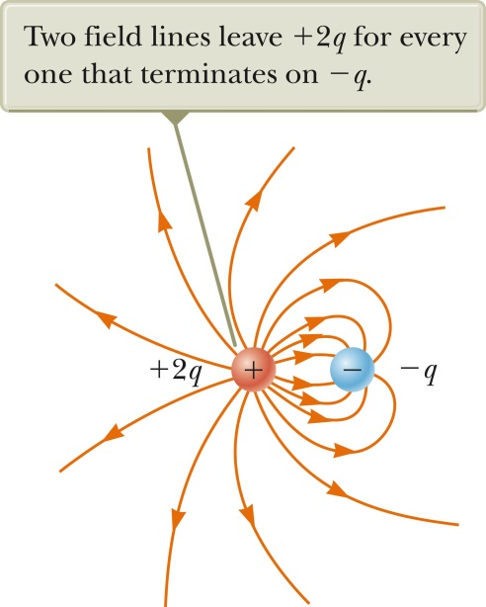
Electric field lines
In order to visualize the electric field we draw a series of field lines that indicate the direction of the field at various points in space.
Lines indicate direction of field, they go from positive to negative
Electric field points along tangent of electric field lines
Density of lines is proportional to field strength
Number of lines starting/ending on a charge is proportional to the magnitude of the charge.
No two lines cross each other (Why?)

Slide 39
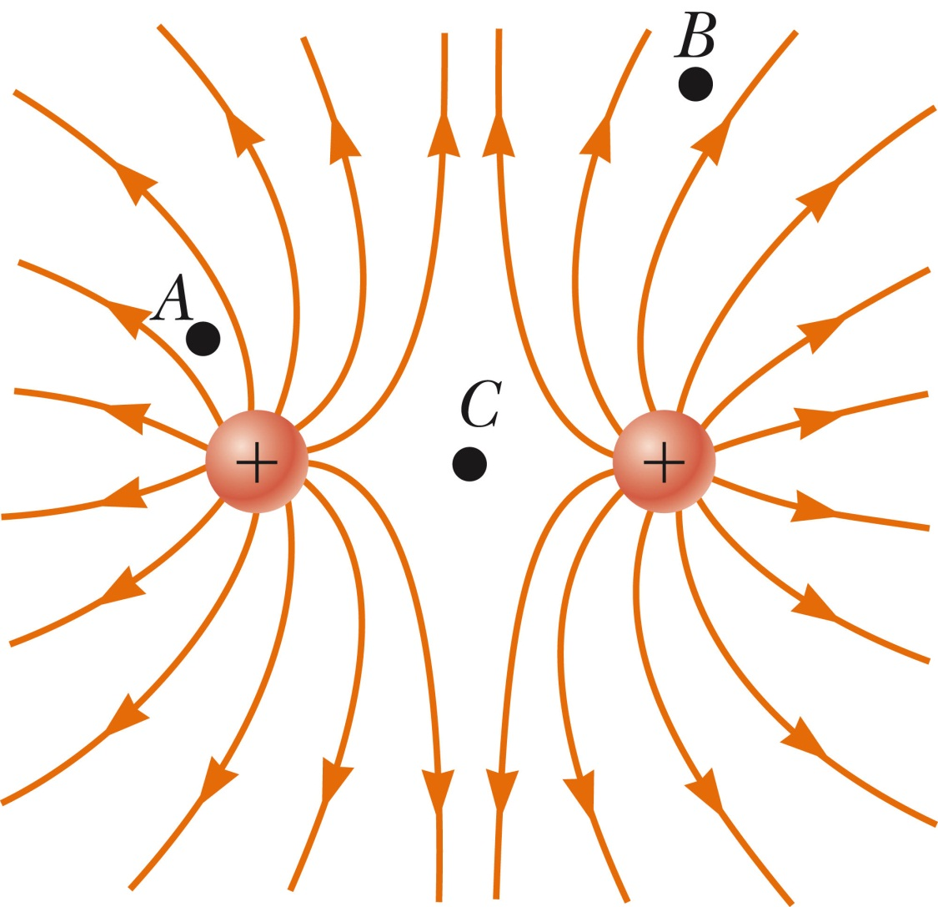
i-clicker 23.4:
Rank the magnitude of the electric field at points A, B, and C (greatest to smallest).
A, B, C
B, C, A
C, A, B
A, C, B
B, A, C

Slide 40
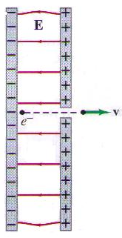
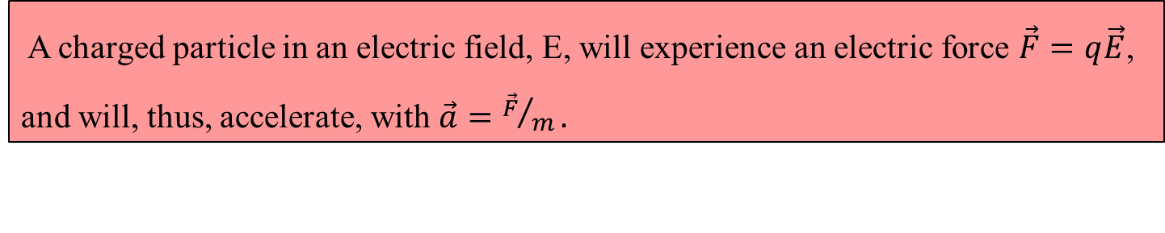
Motion of a Charged Particle in a Uniform Electric Field
A charged particle in an electric field, E, will experience an electric force $\vec{F}=q\vec{E}$, and will, thus, accelerate, with $\vec{a}={\vec{F}}/m.$
White board example 23.4.
An electron (mass, m_{e} = 9.1·10⁻³¹ kg) is accelerated in the uniform electric field (E = 5.0·10⁴ N/C) between two parallel charged plates separated by a distance 1.5 cm. The electron is accelerated from rest near the negative plate and passes through a tiny hole in the positive plate.
(a) Is the gravitational force important in this problem?
(b) With what speed does the electron leave the hole?
Here, gravitational force is 15 orders of magnitude weaker than electric force. Therefore we can typically omit the gravitational force connected with electrons or protons.

Slide 41
Review:
Electric charge - positive, negative
Charge is conserved
Charge is multiple of fundamental charge e = 1.6×10⁻¹⁹ C
Conductors, Insulators
Coulombs law!
Force between point charge distributions (know how to calculate)
Electric field!
Electric field of a point charge distribution (know how to calculate)
Electric field lines
Motion of charges in a uniform electric field
Extra Material: Electric field of a continuous charge distribution

Slide 42
Extra Material

Slide 43
Electric Field from a Continuous Charge Distribution
(can get complicated, quickly…)
P
The concept of charge density
Electric field can come from charge spread on a line, on a surface, or throughout a volume:
Linear charge density λ; units C/m
  Multiply by length
Surface charge density σ; units C/m²
  Multiply by area
Charge density ρ; units C/m³
  Multiply by volume
dl
dA
dV

Slide 44
Electric Field from a Continuous Charge Distribution
Example: Electric field due to a charged rod
White board example 23. 5
A rod of length l has a uniform positive charge per unit length λ and a total charge q. Calculate the electric field at a point P that is located along the long axis of the rod and a distance, a, from one end.
y
x
P
x
a
l
Quick Quiz: Find the electric field at the center of a uniformly charged ring.

